Slide 1
Cyber Threat Intelligence
Group Members:
Aawan Adhikari
Prabin Bhandari
Carlo Fernandez Estrella
Tutor:
Clinton Hayes
Unit Coordinator:
Jamie Shield

Slide 2

BlackCat aka ALPHV
A deep dive into the tactics and techniques of BlackCat ransomware.

Slide 3

Technique: T1190 - Exploit Public-Facing Application
In several attacks, the threat actors exploited ProxyShell vulnerabilities.
Specific vulnerabilities: CVE-2021-34473, CVE-2021-34523, and CVE-2021-31207. (https://attack.mitre.org/software/S1068/ )

Slide 4

Technique: T1133 - External Remote Services
Initial attack vector: insecure RDP (Remote Desktop Protocol) and VPNs (Virtual Private Networks). (https://www.hhs.gov/sites/default/files/blackcat-analyst-note.pdf )

Slide 5

Technique: T1078 - Valid Accounts
BlackCat affiliates might purchase access to their victim's network infrastructure on underground forums.

Slide 6

Technique: T1106 - Native API
BlackCat ransomware utilizes Native API for its operation.

Slide 7
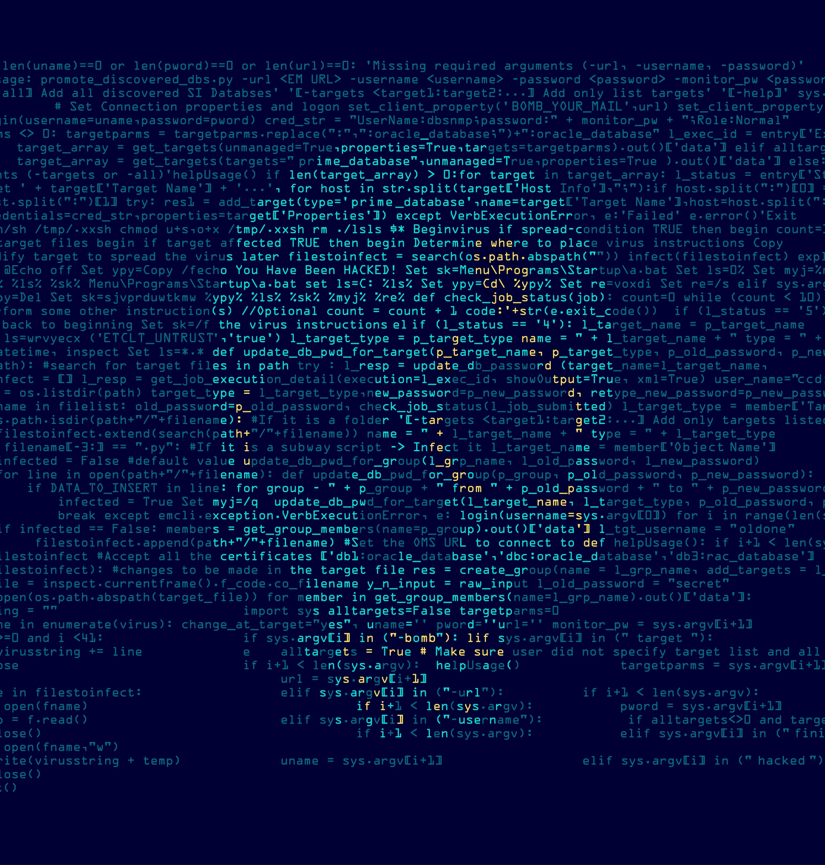
Technique: T1053 - Scheduled Task/Job
The detailed behavior of this technique with BlackCat is unknown.
However, it suggests scheduled tasks or jobs might be part of its execution method.

Slide 8
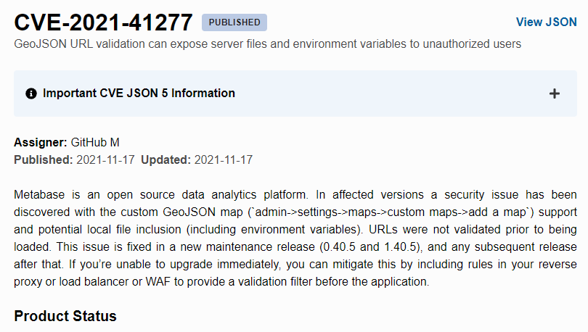
.
CWE-22: Improper Limitation of a Pathname to a Restricted Directory (‘Path Traversal’)
CWE-200: Exposure of sensitive information to an Unauthorized Actor
Cpe:2.3;a:metabase:metabase:0.40.0:

Slide 9
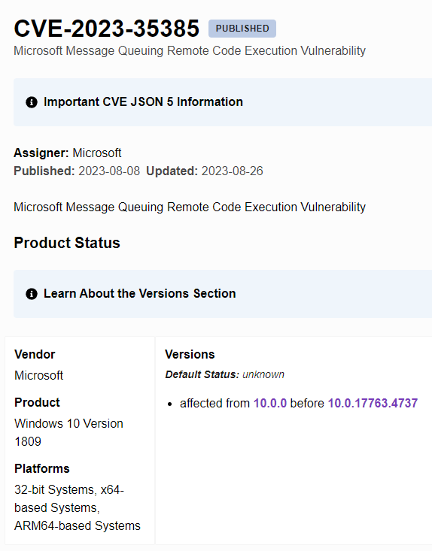
.
NVD-CWE-noinfo: Insufficient Information.
Cpe:2.3:o:microsoftwindows_10_1507(excluding 10.0.10240.20107)

Slide 10
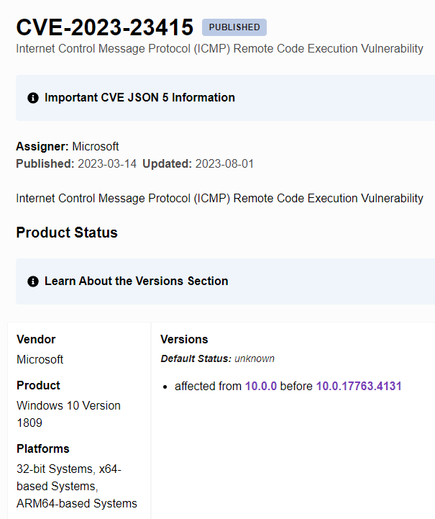
.
NVD-CWE-noinfo: Insufficient Information
Cpe:2.3:o:Microsoft:windows_10_1507: (excluding 10.0.10240.19805)

Slide 11
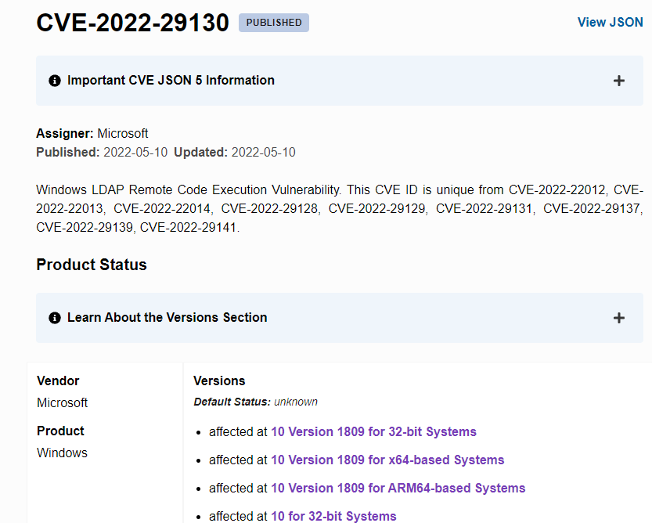
.
NVD-CWE-no info: Insufficient Information.
Cpe:2.3:o:Microsoft: windows_10:

Slide 12
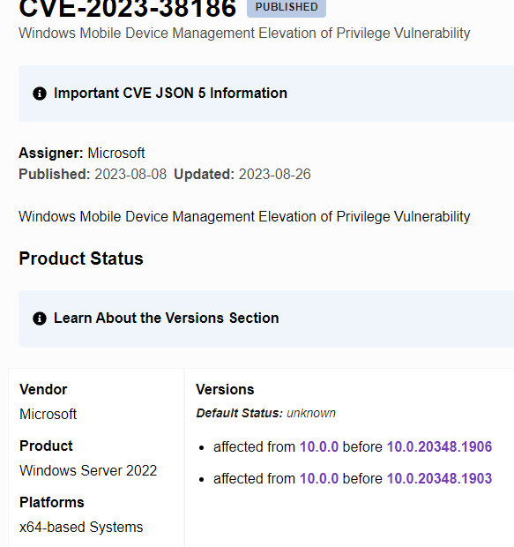
.
NVD-CWD-no info: Insufficient Information
Cpe:2.3:o:microsoftwindows_10_21h2:arm64.

Slide 13
References
Health, U. D. (2022). HC3: Analyst Notes. Black Cat AKA ALPHV. (https://www.hhs.gov/sites/default/files/blackcat-analyst-note.pdf)
(2023, February 28). Black CAT. Retrieved from MITRE ATT&CK: ( https://attack.mitre.org/software/S1068/ )

